Slide 1
Chapter 5 Augmented reality
AR, VR, and MR..

Slide 2
Unit objectives
At the end of this chapter students are will be able to answer the following questions;
Explain augmented reality
Explain the features of augmented reality
Explain the difference between AR, VR, and MR
Explain the architecture of augmented reality systems
Describe the application areas of augmented reality

Slide 3
Augmented Reality(AR)
Augmented Reality(AR) is a view of the physical real-world environment with superimposed computer-generated images; thus, changing the perception of reality.
It can be said also a live direct or indirect view of a physical, real-world environment whose elements are augmented by computer-generated sensory input such as sound, video, graphics or GPS data.
AR integrates digital information with the user's environment in real-time.

Slide 4
Augmented Reality Cont’d
Its influential effect is achieved by ensuring that the virtual content is aligned and registered with the real objects.
Unlike virtual reality, which creates a totally artificial environment, augmented reality uses the existing environment and overlays new information on top of it.
You can simply experience AR using smartphones by downloading AR apps or may be with the help of special AR headsets, such as Google Glass, where digital content is displayed on a tiny screen in front of a user’s eye.
Examples of augmented reality experiences include Snapchat lenses and the game Pokemon Go

Slide 5
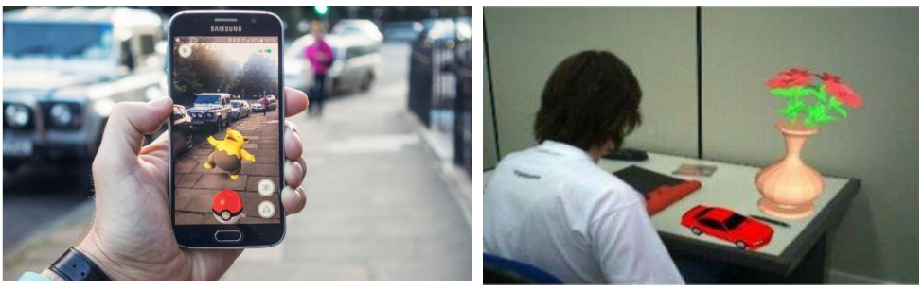
Augmented Reality Cont’d
Direct and Indirect Augmentation of Objects
Notes:
Direct and Indirect Augmentation of Objects

Slide 6
Virtual Reality(VR)
VR is fully immersive, which tricks your senses into thinking you’re in a different environment or world apart from the real world
Using a head-mounted display (HMD) or headset, you’ll experience a computer-generated world of imagery and sounds in which you can manipulate objects and move around using haptic controllers while tethered to a console or PC.
VR simulates a computer-generated realistic experience.
Typically VR blocks out the real world (“Reality”)and replaces it with a “Virtual” world.
Advanced VR environment will engage all five senses (taste, sight, smell, touch, sound)

Slide 7
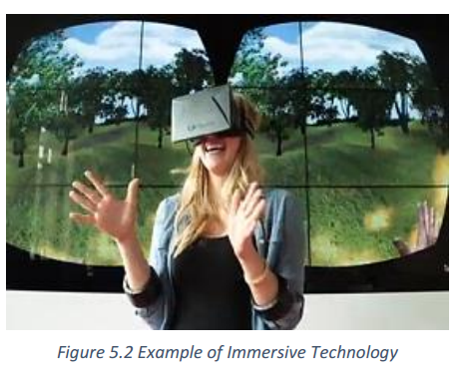
Virtual Reality(VR) Cont’d
Some of popular VR devices such as HTC Vive, Ocul us Rift or Google Cardboard and special hand controllers can be used to enhance it’s experiences.
Most VR headsets are connected to a computer (Oculus Rift) or a gaming console (PlayStation VR)
There are also standalone devices (Google Cardboard is among the most popular).

Slide 8
Mixed Reality(MR) Cont’d
Mixed Reality (MR) sometimes referred to as hybrid reality.
It is the merging of real and virtual worlds to produce new environments and visualizations; where physical and digital objects co-exist and interact in real-time.
It means placing new imagery within a real space in such a way that the new imagery is able to interact, to an extent, with what is real in the physical world we know.
For example, with MR, you can play a virtual video game, grab your real-world water bottle, and smack an imaginary character from the game with the bottle.

Slide 9
Mixed Reality(MR) Cont’d
The key characteristic of MR is that the synthetic content and the real-world content are able to react each other in real-time.
Next-generation sensing and imaging technologies allows us to interact with and manipulate physical and virtual items in MR.
Mixed reality hardware is still emerging and hasn’t quite broken into the mainstream consumer market, most likely due to the price.
The consumer releases of the Microsoft HoloLens and Magic Leap One retail for over $2000 USD, which is 3 to 4 times the cost of the PlayStation VR and HTC Vive VR headsets
Thus MR applications require exponentially high processing power built on the top of powerful hardware.

Slide 10
Mixed Reality(MR) Cont’d
Microsoft HoloLens tool is comprise the following components;
Built-in microphone array
Binaural sound capabilities
A built-in camera for recording
A depth sensor
Head-tracking cameras and
An inertial measurement unit which helps track your head movement.

Slide 11
Architecture of AR Systems
The first Augmented Reality Systems (ARS) were usually designed with a basis on three main blocks
Infrastructure Tracker Unit
Responsible for collecting data from the real world, sending them to the Processing Unit
Processing Unit
Mix the virtual content with the real content and sent the result to the Video Out module of the Visual Unit
Visual Unit

Slide 12
Architecture of AR Systems Cont’d
The Visual Unit can be classified into two types of system based on the visualization technology:
Video see-through: It uses a Head-Mounted Display (HMD) that employs a video-mixing and displays the merged images on a closed-view HMD.
Optical see-through: It uses an HMD that employs optical combiners to merge the images within an open-view HMD.

Slide 13
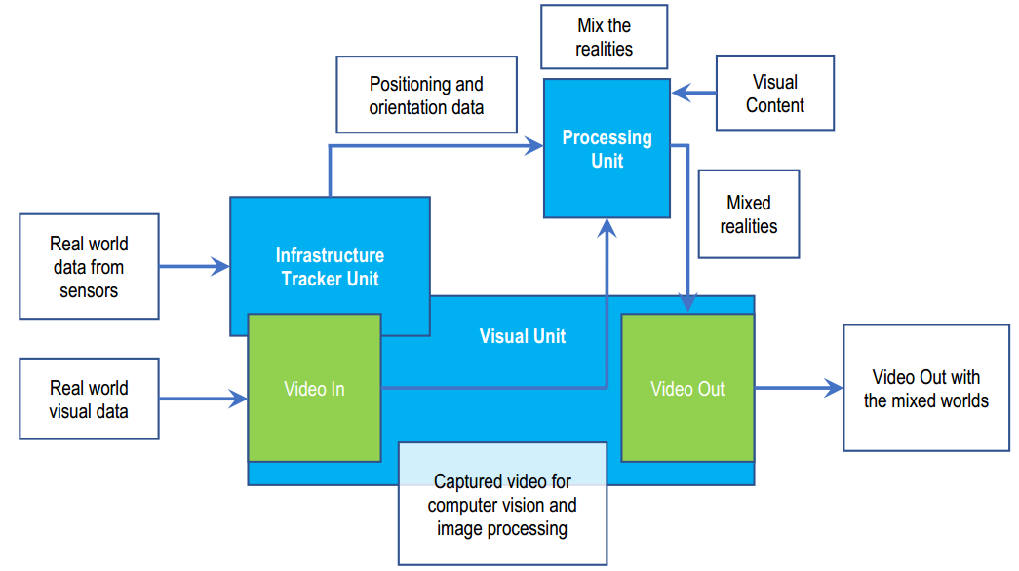
Architecture of AR Systems
Augmented reality systems standard architecture

Slide 14
AR, VR Vs. MR
With constant development in computer vision and the exponential advancement of computer processing power, virtual reality (VR), augmented reality (AR), and mixed reality (MR) technology is becoming more and more prominent.
There is some overlap in the applications and functions of these emerging technologies, sometimes these terms get confused or are used incorrectly.
One of the most obvious differences among augmented reality, virtual reality, and mixed reality is the hardware requirements. Moreover, the following are basic differences;
VR is content which is 100% digital and can be enjoyed in a fully immersive environment,
AR overlays digital content on top of the real-world and
MR is a digital overlay that allows interactive virtual elements to integrate and interact with the real-world environment.

Slide 15
Application of AR Systems
Recently a fast developing technologies is augmented reality (AR), which can be applied to many different disciplines such as ;
AR in Education
AR In Medicine
AR In Entertainment and
Military

Slide 16
Application of AR Systems Cont’d
AR in Education
Augmented reality allows flexibility in use that is attractive to education.
AR technology can be utilized through a variety of mediums including desktops, mobile devices, and smartphones.
Affordable learning materials - posters, digital illustrations, physical models, prototypes are very expensive and it’s impossible for schools to find enough money to purchase all the supplementary materials they would like to.
Using AR technology allows for avoiding investments in physical materials.
Interactive lessons - when AR technology is used in classrooms, students can view models on their own smartphones and get a better idea of the concepts they are studying.
Higher engagement, Higher retention, Boost intellectual curiosity

Slide 17
Application of AR Systems Cont’d
AR in medicine
Augmented reality has the potential to play a big role in improving the healthcare industry.
This new technology is enhancing medicine and healthcare towards more safety and efficiency. For example, augmented reality has already made significant changes in the following medical areas:
Surgery (minimally invasive surgery);
Education of future doctors;
AR tools may also aid to detect the signs of depression and other mental illnesses by reading from facial expressions, voice tones, and physical gestures.

Slide 18
Application of AR Systems Cont’d
AR in Entertainment
Augmented reality can be used in various “entertainment” industries as entertainment covers quite a number of different industries – music, movies, live shows, games – and all of them can benefit from using augmented reality.
AR in games
AR in music
AR on TV
AR in eSports

Slide 19
References
Tesfahunegn M., Makonen W., Yonassa T. and Girma D. (2019). “Introduction to Emerging Technologies Course Module”; MOSHE
Steve M., Tom F., Yu Y., Jay I., and Zixin W.. (2018). “All Reality: Virtual, Augmented, Mixed(X), Mediated(X,Y),and Multimediated Reality”, Multimediated Reality; arXiv:1804.08386v1
Paolo Fogliaroni. (2012).“Mixed Reality for Archeology and Cultural Heritage ”; https://orcid.org/0000-0002-0578-8904

